Slide 1
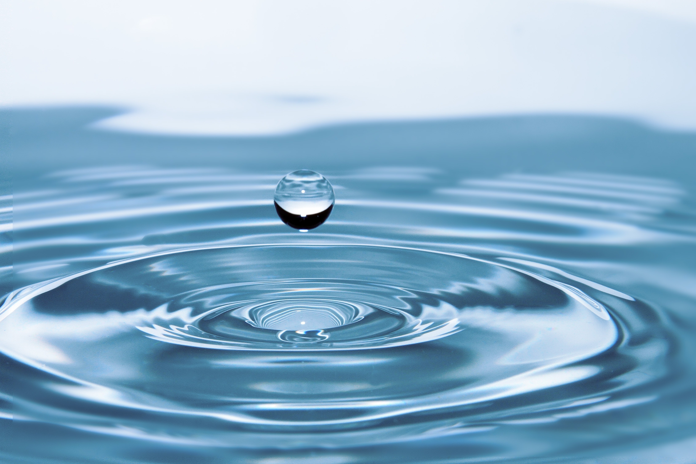
IOT PROJECT
TITLE: WATER CONSERVATION
TEAM:
Abhay Raj
Alok Ranjan
Harsh Pandey
Shubhabas Patra
Yakshit Israni

Slide 2
Aim:-
Developing Projects to Solve Real-World Problems:
Water Conservation:-
To design a Smart Water Level Indicator for Water Conservation using Arduino that monitors water usage in a household and ensures that daily consumption does not exceed the UN-recommended limit of 40 liters per person per day, while also preventing water wastage.

Slide 3
Theory:-
Water conservation is crucial for sustainable living. By monitoring water usage, individuals can be more mindful of their consumption.
This project employs an ultrasonic sensor to measure the water level in a storage tank and calculates daily water usage.
An OLED display shows real-time water levels and consumption, while a buzzer alerts the user when consumption exceeds the daily limit. This system helps in better water management and reduces unnecessary wastage.

Slide 4
List of Components:-
Component | Specification | Quantity
Arduino UNO | ATmega328P | 1
Ultrasonic Sensor | HC-SR04 | 1
0.96” Oled Display | 16x2 | 1
Buzzer | 5V | 1
LED | Red, Yellow, Green | 3
Jumper Wires | Male-Female | 10+
Power Supply | 5V Adapter/Battery | 1

Slide 5
Working:-
WWater Level Measurement
TThe HC-SR04 ultrasonic sensor is placed above the water tank.
IIt emits ultrasonic waves, which reflect back from the water surface.
TThe time taken for the echo to return is measured to calculate the water level.

Slide 6
Working:-
UUsage Calculation
TThe initial water level is recorded.
AAs water is used, the sensor detects the decrease in water level.
TThe difference between previous and current water levels is calculated and accumulated as total daily usage.

Slide 7
Working:-
◦ The OLED display continuously updates with the current water level and daily water usage.
◦ If daily water usage exceeds 40 liters per person, the buzzer is triggered as an alert.
◦ By monitoring consumption, users can adjust their water usage behavior.
◦ The system helps in detecting water wastage and promoting efficient usage.

Slide 8
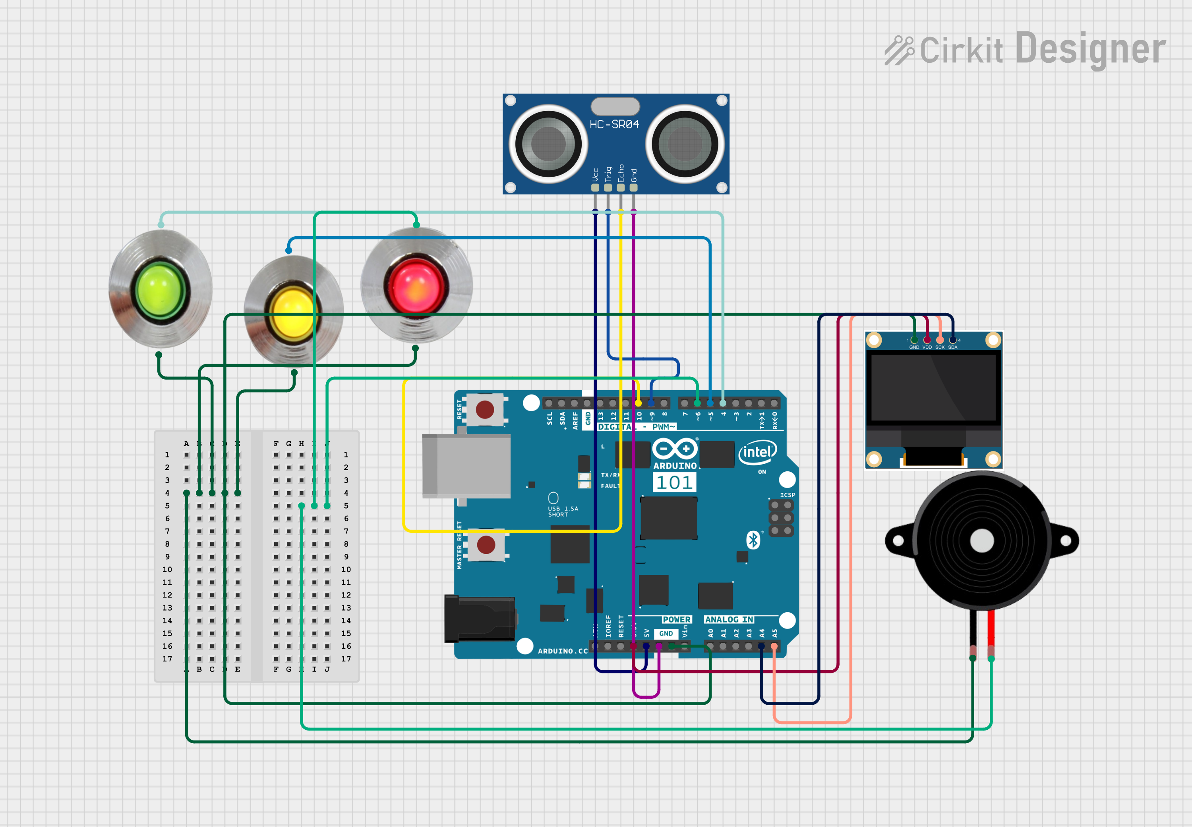
Circuit Diagram:-

Slide 9
DEMONSTRATION
TIME!!!

